Slide 1
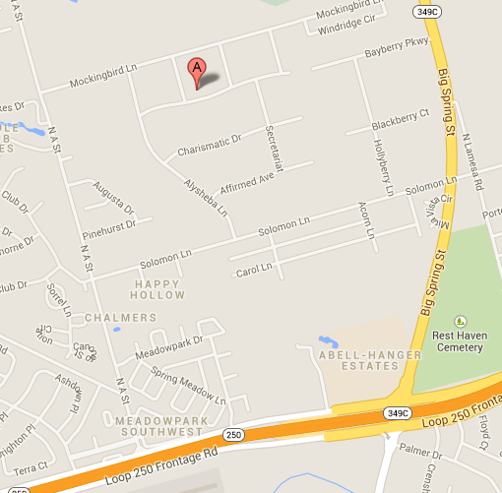
5400 Unbridled Trail

